Slide 1
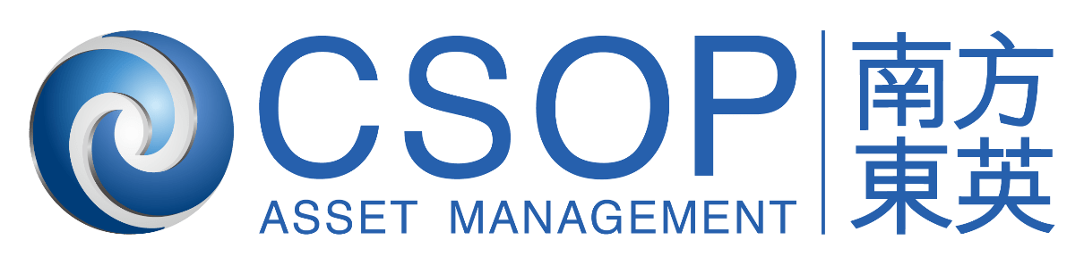
Korea Market Outlook 2H26 Bumpy but Higher — Earnings-Driven Rally with Manageable Leverage
July 2026
Caleb Wong
Summer Intern, PCS
CSOP Asset Management Limited

Slide 2


01
1H26 Korea Market Recap
CSOP Asset Management

Slide 3
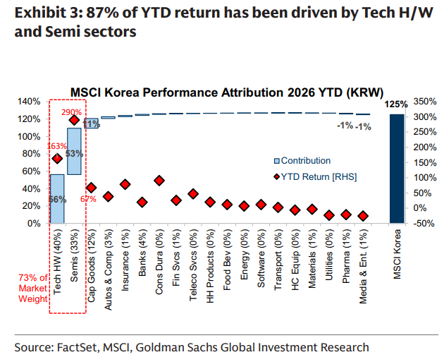
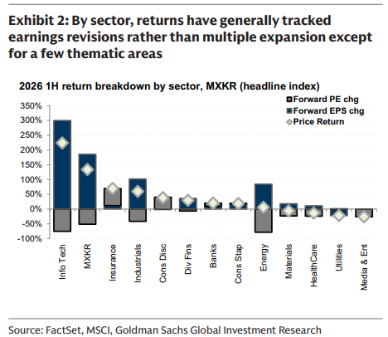
Korea's 1H26 Rally Was Exceptional, but Highly Concentrated in Tech/Memory
Figure 1.1 — Korea Performance Attribution 2026 YTD
Figure 1.2 — Korea’s 2026 1H Return Breakdown by Sector
[Chart: MSCI Korea Performance Attribution 2026 YTD]
Tech HW (40%) + Semis (33%) = 73% of market weight
87-92% of YTD gains from tech hardware/semiconductors
[Chart: Performance Breakdown by Market, MSCI Asia (2026 1H)]
Korea leads with ~125% price return (USD)
Driven by Forward EPS changes, not PE expansion
Key Insight:
Strongest equity market in Asia in 1H26: KOSPI up ~90% YTD
Highly concentrated: Leadership concentrated in a handful of AI "bottleneck" and memory beneficiaries
Tech Hardware and Semiconductors account for >73% of index weight;
87%-92% of Korea's YTD gains are from tech hardware/semiconductors as well
Source: Goldman Sachs, FactSet, MSCI, Quantiwise
03

Slide 4
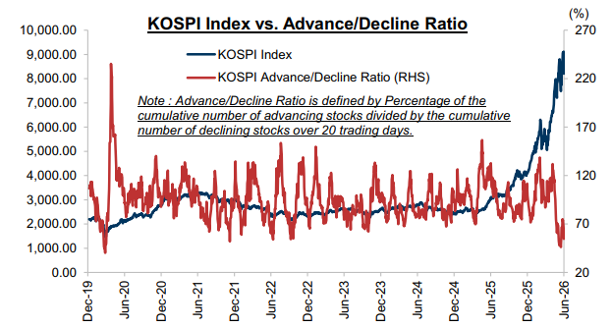
How Concentrated? Market Breadth Narrowed to COVID-Era Lows Despite Successive All-Time Highs
Figure 1.3 — KOSPI vs. Advance/Decline Ratio
[Chart: KOSPI Index vs. Advance/Decline Ratio]
Ratio at weakest since COVID despite KOSPI at all-time highs
Key Insight:
Advance/Decline Ratio tracks market "breadth”
Dropped to <70%, weakest since COVID despite successive all-time highs
A low ratio indicates the rally was driven by a tiny handful of massive heavyweight stocks
Leadership concentrated in AI "bottleneck" and memory beneficiaries
Within the AI “bottleneck”, current cycle extends beyond the top two names into robotics, industrial automation, and energy infrastructure
Source: Goldman Sachs Global Investment Research, FactSet, MSCI, Quantiwise
04

Slide 5
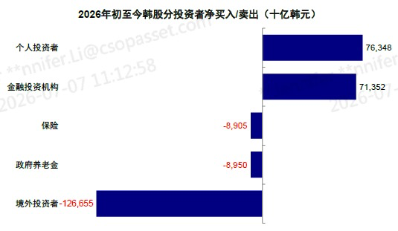
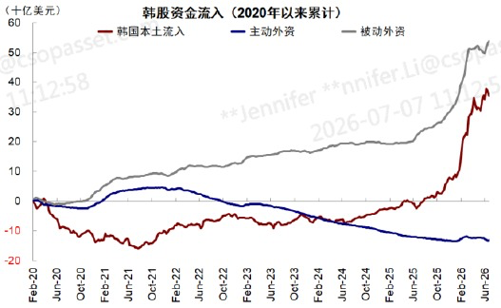
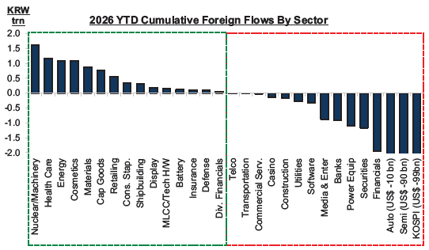
1H Fund Flow Dynamics: Foreign Investors Sold Heavily While Domestic Retail Absorbed Flows
Figure 1.6 — 2026 YTD Net Buying/Selling by Investor Type (KRW billions)
Figure 1.7 — Cumulative Equity Fund Flows in Korea (Since 2020, USD billions)
[Chart: Cumulative Foreign Flows vs. MSCI Korea]
Foreign sold US$27.9bn in June 2026
[Chart: Cumulative Domestic Retail & Institutional Flows]
Domestic bought US$27.5bn, offsetting foreign outflows
Figure 1.8 — Cumulative Foreign Flows by Sector
[Chart: 2026 YTD Cumulative Foreign Flows By Sector]
Rotated out of semiconductors/autos
Rotated into Nuclear, Machinery, Health Care, Energy, Materials
Flow Dynamics:
Foreign: Sold US$27.9bn of Korean equities in June 2026, US$84.8bn YTD
Domestic: Bought US$27.5bn in June , US$98.8bn YTD; offset foreign outflows
Market flow dominated by retail: 46% of KOSPI turnover value & 71% of transaction volume
Foreign: 34% value, 24% volume; Domestic institutions: 20% value, 5% volume
Foreign flows rotated out of semis/auto sectors while rotating into broader industrial themes, i.e. Nuclear, Machinery, Health Care, Energy, Materials
Source: Morgan Stanley, Goldman Sachs, CICC
05

Slide 6
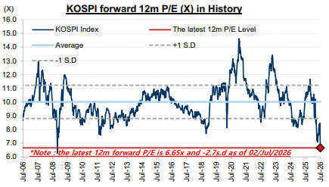
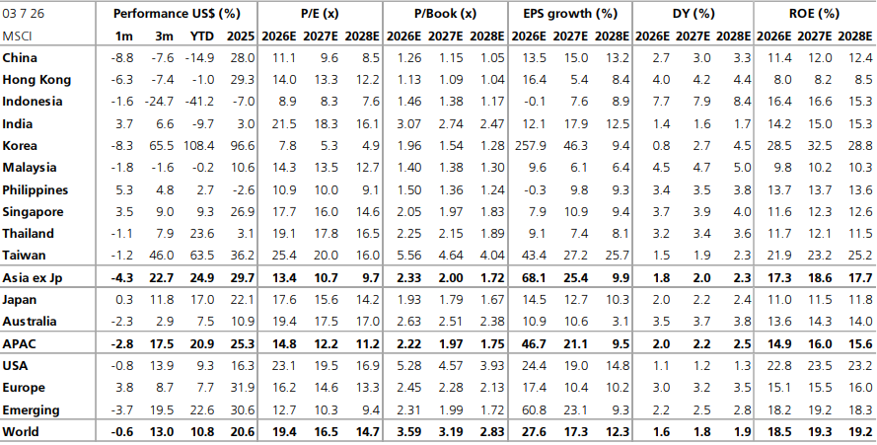
Earnings, Not Multiple Expansion, Drove the Rally — the ”Korea Discount” Persists
Figure 1.4 — KOSPI Forward 12m P/E
Figure 1.5 — MSCI Korea Valuation Comps
[Chart: KOSPI Forward 12m P/E History]
Forward P/E compressed from ~10x to ~6.65x
despite >200% EPS growth
[Chart: PBR Comparison Across Markets]
>70% of KOSPI companies trade below book value
Korea has highest % of companies with <1x P/B
Key Insight:
Forward 12m P/E compressed from ~10x to ~6.65x, lowest level since 2008
Korea's PEG ratio is now the lowest in the region at ~0.03
The rally is fundamentally justified by earnings (258% EPS growth) rather than speculative multiple expansion
“Korean Discount” Factors: high cyclicality & Concentration Risk, Foreign-Flow & FX sensitivity, governance & minority-shareholder risk, conglomerate holding-company structures, geopolitics…
Source: Goldman Sachs, UBS, Bloomberg
06

Slide 7
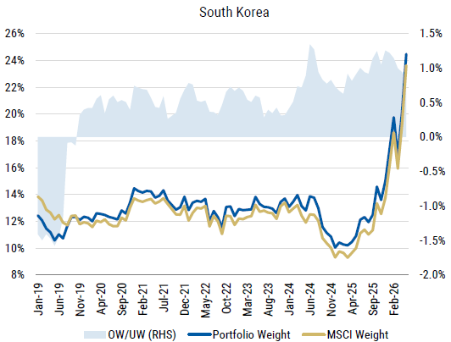
GEM Portfolio Overweight Surged — Korea Now Among the Most Over-Owned EM Markets with Strong Momentum
Figure 1.9 — GEM Portfolio Weight in Korea vs. MSCI Weight in Korea
[Chart: GEM Fund Manager Portfolio Weight in South Korea vs. MSCI Weight]
Korea + Taiwan = ~50.4% of GEM portfolios (May 2026)
Positioning Context:
Korea's weight in global EM portfolios has risen sharply to ~24%
Korea + Taiwan combined weight reaching about 50.4% of GEM portfolios as of May 2026
Korea is now among the most over-owned EM markets, overweighted (over-owned) by ~1%
"Over-owned" = managers' allocation to Korean equities is above Korea's weight in the MSCI EM benchmark
GEM portfolios refer to the composite of the 40 largest active US Emerging Markets Equity funds and 40 largest active international/SICAV Emerging Markets Equity funds, covering approximately US$260bn in AUM, on a MV-weighted basis
Source: Morgan Stanley.
07

Slide 8
02
Korea Market Leverage
CSOP Asset Management

Slide 9
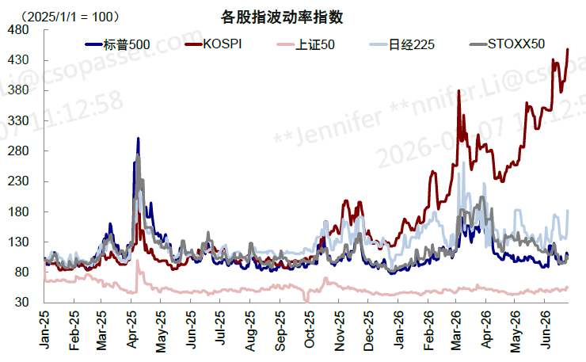
Korea Has Exhibited Significantly Higher Volatility Compared to Other Major Global Market Indices
Figure 2.1 — Volatility of Major Global Indices
[Chart: GEM Fund Manager Portfolio Weight in South Korea vs. MSCI Weight]
Korea + Taiwan = ~50.4% of GEM portfolios (May 2026)
Positioning Context:
KOSPI exhibits significantly higher volatility compared to other major global market indices
This divergence has been increasingly evident since the start of 2026
Some of the factors…
Concentration in Tech Hardware/Semis/AI Bottlenecks, High Beta & Cyclical, Foreign-flow Sensitivity, Retail-led Turnover, Leverage
How elevated is Korea’s market leverage, and is it really that extreme?
Source: Morgan Stanley.
09

Slide 10
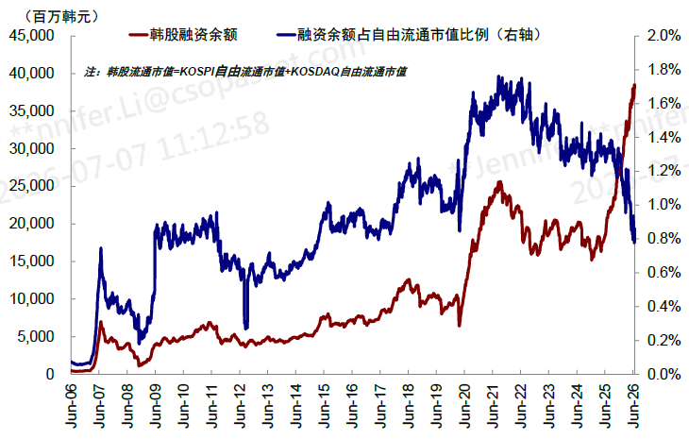
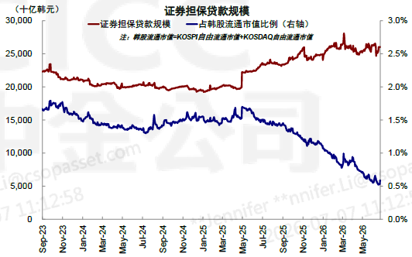
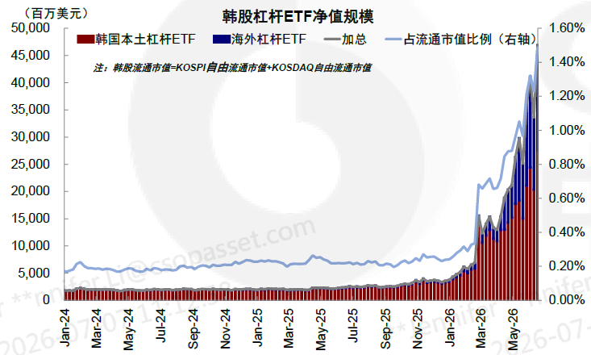
Absolute Leverage Reached Historic Highs…
Figure 2.2 — Time Series of Broker Margin Loan Levels
Figure 2.3 — Time Series of Securities-Backed Loan Levels
[Chart: Volatility of Major Global Indices]
KOSPI exhibits significantly higher volatility
[Chart: Time Series of Broker Margin Loan Levels]
KRW 38tn in margin loans
0.90% of free-float mkt cap (vs US 2.0%, China 5.3%)
Figure 2.4 — Time Series of Leveraged ETF Levels
[Chart: Time Series of Leveraged ETF Levels]
KRW 65tn in leveraged ETFs (1.5% of free-float)
Leverage Breakdown:
Absolute basis: Total broad leverage KRW 270.6tn (historic high)
Exchange-traded:
Broker margin loans: KRW 38tn
Leveraged ETFs: KRW 65tn (24%)
Onshore futures: KRW 126tn (47%)
OTC:
Contract for Differences (CFDs): KRW 3.6tn
Securities-backed loans: KRW 26tn
Equity-Linked Securities: KRW 12tn
Source: CICC Research
10

Slide 11
A More Balanced Picture: Relative Leverage Metrics Do Not Indicate Extreme Systemic Risk
Figure 2.5 — Time Series of Broker Margin Loan Levels
Figure 2.6 — Time Series of Leveraged ETF Levels
[Chart: Volatility of Major Global Indices]
KOSPI exhibits significantly higher volatility
[Chart: Time Series of Broker Margin Loan Levels]
KRW 38tn in margin loans
0.90% of free-float mkt cap (vs US 2.0%, China 5.3%)
Leverage Breakdown:
Relative basis: Total broad leverage sits at a manageable 6.24% of the free-float market cap (KOSPI + KOSDAQ)
Exchange-traded:
Broker margin loans: 0.90%, a sharp decline from the 1.8% peak seen in 2021, and significantly lower than current margin levels in the US (2.0%) and China (5.3%)
Leveraged ETFs: 1.5%, surged from ~0.30% at year-end 2025
The only leverage instrument to record an increase relative to the free-float market cap. Turnover breakdown: Foreigners (43%), Retail (32%), Domestic Institutions (25%)
Onshore futures: 2.9%
OTC:
CFDs: 0.08%, Securities-backed loans: 0.06%, Equity-Linked Securities: 0.26%
All leverage metrics have declined on a relative basis, except for leveraged ETFs
Source: CICC Research
11

Slide 12
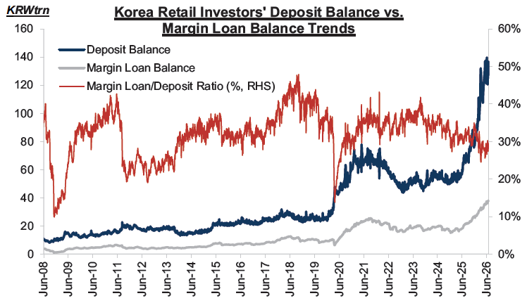
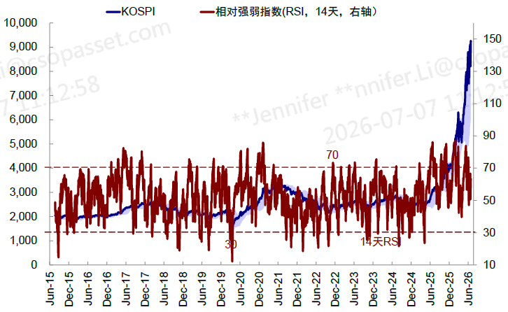
Contained Systemic Risk – Margin-to-Deposit Ratio Declining, RSI Below Overbought Threshold
Figure 2.7 — Time Series of Korea Retail Deposit vs. Margin Loan Balance
Figure 2.8 — Time Series of KOSPI RSI
[Chart: Retail Investors' Deposit Balance vs. Margin Loan Balance]
Deposit growth outpacing margin loan growth
Margin loan-to-deposit ratio declining
[Chart: KOSPI RSI Time Series]
RSI fell back to <60
Below past stress peaks and overbought threshold
Risk Mitigation Indicators:
Domestic deposit balances have expanded at a much faster pace than retail margin loans — the margin loan-to-deposit ratio has been declining
Korea's RSI fell back to <60, remaining below past stress peaks and the overbought threshold
Low Valuations + High EPS Growth act as a powerful fundamental shock absorber against any potential margin/leverage-induced volatility
Source: CICC Research, Goldman Sachs.
12

Slide 13
From Leverage to Volatility: Retail Margin Liquidations Meet the July 2026 FSC Crackdown
01
The Margin Mechanics & Liquidation Spiral
02
The July 2026 FSC Regulatory Crackdown
Korea's retail margin rules set the trip-wire for forced selling:
Minimum 40% initial margin and a 140% collateral maintenance ratio
Brokers can tighten to 60% / 160% for volatile stocks
A 16–36% price drop can breach maintenance and trigger margin calls — plausible given Korea's volatility
Margin-loan balances have climbed toward record highs above KRW 30 trillion, leaving the market primed for cascade selling
This sets off a two-step liquidation spiral:
Cash-short investors sell liquid holdings to meet calls, squeezing market liquidity.
Those who fail to top up in time are force-liquidated, driving prices lower and restarting the loop.
On July 16, 2026, the FSC unveiled sweeping curbs on single-stock leveraged ETFs to cool the retail leverage frenzy:
Temporary halt to new listings of single-stock leveraged, inverse and covered-call products until market conditions stabilize
Marketing ban on advertising and promotional events for existing single-stock leveraged products
Minimum cash deposit tripled to KRW 30M (from KRW 10M) to open/trade SSLI, cash-only (substitute securities no longer count; absolute cash barrier to entry)
Lot size raised to 20 units (from 1), lifting the entry barrier for retail
Tighter price-deviation controls, with stronger accountability for liquidity providers and asset managers
Retail margin mechanics and forced-liquidation spirals remain Korea's primary volatility amplifier — and the July 2026 FSC crackdown is a direct attempt to cool the
leverage frenzy before it destabilizes the broader market.
Source: Reuters;,WSJ, Goldman Sachs, CICC Research. Listing and marketing restrictions take effect immediately; the KRW 30M deposit requirement begins August 5, cash-only recognition begins August 19, and the 20-unit trading lot is scheduled for November 2026
13

Slide 14
From Leverage to Volatility: Dealer Hedging and Leveraged ETF Short-Gamma Risks
Leveraged ETF "Gamma" Risk:
Leveraged ETFs have grown rapidly in size and influence
When the index falls, ETF dealers hedge by selling index futures ("Short Gamma"), which can mechanically accelerate intraday declines, especially around rebalance points and the close
This creates a reflexive feedback loop: falling prices → dealer hedging → more selling pressure → further price declines
Initial Market Decline
Volatility Feedback loop — restarts the cycle
Retail Margin Liquidations
ETF “Short-Gamma” Hedging
Prices drop 16–36% → margin calls triggered → brokers forcefully liquidate retail positions.
Index falls → leveraged ETF asset base shrinks → dealers sell index futures to maintain 2x exposure.
Amplified Selling Pressure & Liquidity Squeeze
Source: CICC Research, Goldman Sachs.
14

Slide 15
03
Into 2H26 –
July Fund Flows
CSOP Asset Management

Slide 16
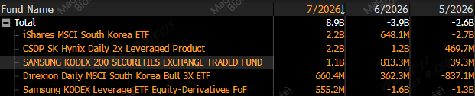
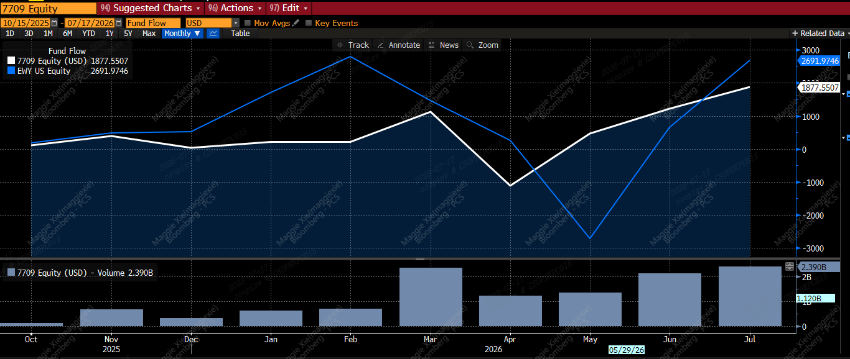
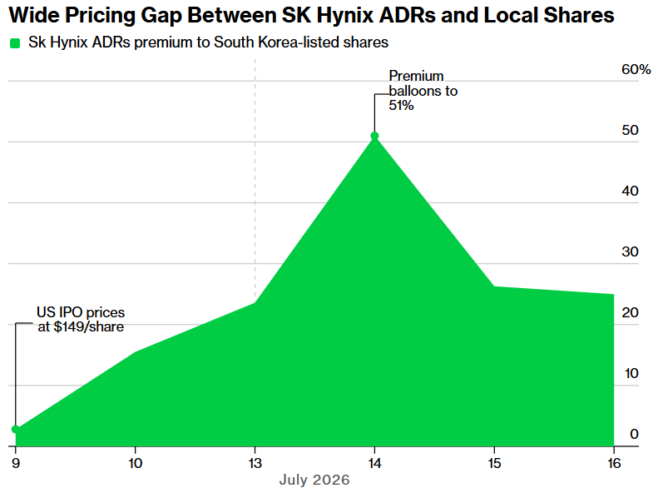
Into 2H26 - July Fund Flow Dynamics: A Sharp Reversal from 1H Outflows
Figure 3.1 — Monthly Net Flows: Top Five South Korea–Exposed ETFs by July 2026 Flow
Figure 3.2 — Monthly Fund Flows: CSOP 7709 vs. iShares MSCI South Korea ETF (EWY)
[Chart: Volatility of Major Global Indices]
KOSPI exhibits significantly higher volatility
[Chart: Time Series of Broker Margin Loan Levels]
KRW 38tn in margin loans
0.90% of free-float mkt cap (vs US 2.0%, China 5.3%)
Figure 3.3 — Time Series of SK Hynix ADRs Premium to South Korea-listed Shares
Why Did Flows Rebound Sharply in July?
[Chart: Time Series of Leveraged ETF Levels]
KRW 65tn in leveraged ETFs (1.5% of free-float)
Dip-buying after the sell-off: Retail deployed cash into the late-June correction, with net buying KRW 27tn of equities and KRW 8.8tn of local equity ETFs, while customer deposits fell KRW 21tn
EWY as an efficient SK Hynix proxy: Record EWY inflows reflected demand for Korea-listed SK Hynix exposure without paying for the more expensive US ADR, whose premium briefly exceeded 50% in mid-July
ADR conversion constraints sustained the gap: ADR issuance/cancellation remained restricted until 29 July (conversion books were closed), limiting arbitrage; EWY provided a liquid US-hours alternative without direct Korean-market or FX execution
Source: Bloomberg, data as of 17 July 2026. Chosun Biz.
Note: SK Hynix ADR’s conversion books were temporarily closed until the new Korean shares became transferable/listed on July 29. Before then, Citibank, the depositary bank, could not freely process ADR issuance or cancellation because the underlying newly issued common shares had not yet listed on the Korea Exchange.
16

Slide 17
04
2H26 Earnings Expectation
CSOP Asset Management

Slide 18
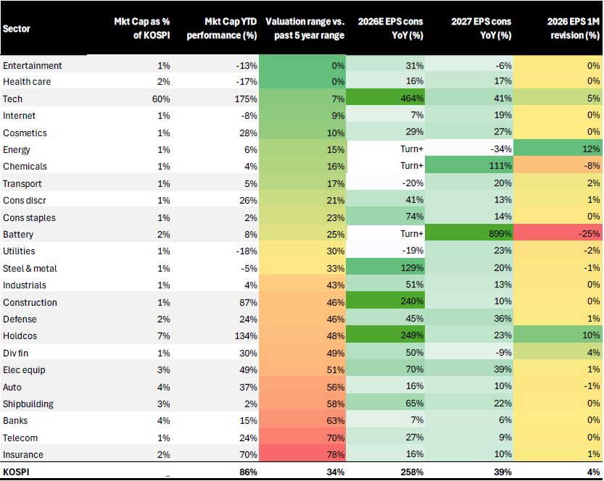
Earnings Expectation: Cycle Remains Powerful with Tech/AI as the Core Engine
Figure 4.1 — Sector Screen: EPS Growth, Revision, and Valuations
[Chart: Sector Screen — EPS Growth, Revision, and Valuations]
Tech: 60% of KOSPI mkt cap, 464% EPS growth 26E
Broadening into construction, industrials, defense
Earnings Outlook:
Sell-side remains constructuive
Goldman Sachs: Korea EPS growth 320% in 2026, 35% in 2027
UBS: Korea EPS growth 258% in 2026, 46% in 2027
Tech/AI core engine: 60% of KOSPI mkt cap, 464% EPS growth 26E, 41% EPS growth 27E
Broadening recovery: Construction, electrical equipment, shipbuilding, industrials, defense show strong earning growth / positive revisions
Source: UBS, Goldman Sachs.
18

Slide 19
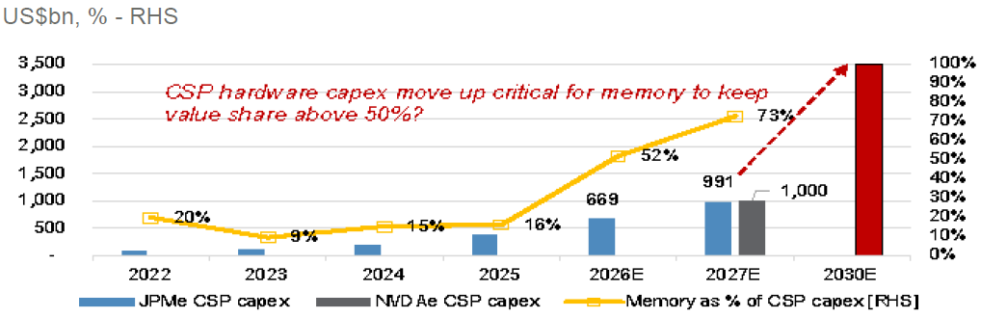
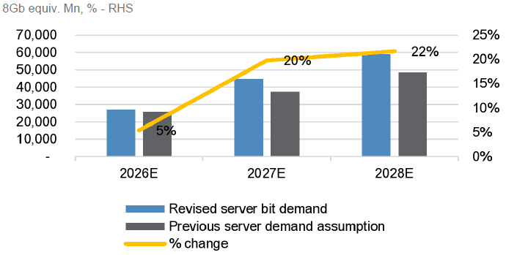
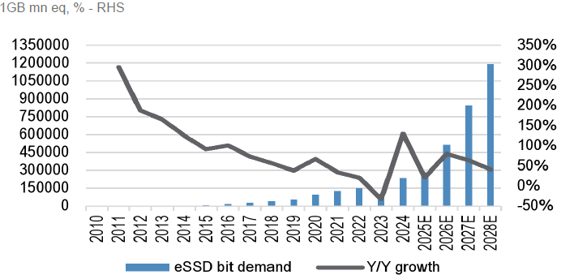
Demand Dynamics: What Drove Strong Earnings Growth in Tech/AI/Memories
Figure 4.2 — Cloud Service Provider CapEx and Memory as % of CSP Capex Forecast
Figure 4.3 — AI Server Bit (DRAM) Demand Growth Forecast
[Chart: Retail Investors' Deposit Balance vs. Margin Loan Balance]
Deposit growth outpacing margin loan growth
Margin loan-to-deposit ratio declining
[Chart: KOSPI RSI Time Series]
RSI fell back to <60
Below past stress peaks and overbought threshold
Figure 4.4 — eSSD Bit Demand Growth Forecast
We all know HBM demand has surged, but the story is broader than it may seem:
[Chart: Time Series of Leveraged ETF Levels]
KRW 65tn in leveraged ETFs (1.5% of free-float)
Memory is expected to account for 52% of Cloud Service Provider Capex 2026E
The AI-memory thesis is evolving from HBM scarcity into a broader multi-year memory supply constraint
UBS: AI workloads to lift demand not only for HBM, but also DDR5/LPDDR5 in conventional servers (they are DRAM and Figure 3.3 shows its demand growth)
UBS: expects AI to lift demand for eSSD (>50% Y/Y growth since 2026)
DRAM: server working memory; HBM: high-speed DRAM for AI; NAND: storage memory chip; eSSD: enterprise storage drive built with NAND
Source: JP Morgan, UBS.
19

Slide 20
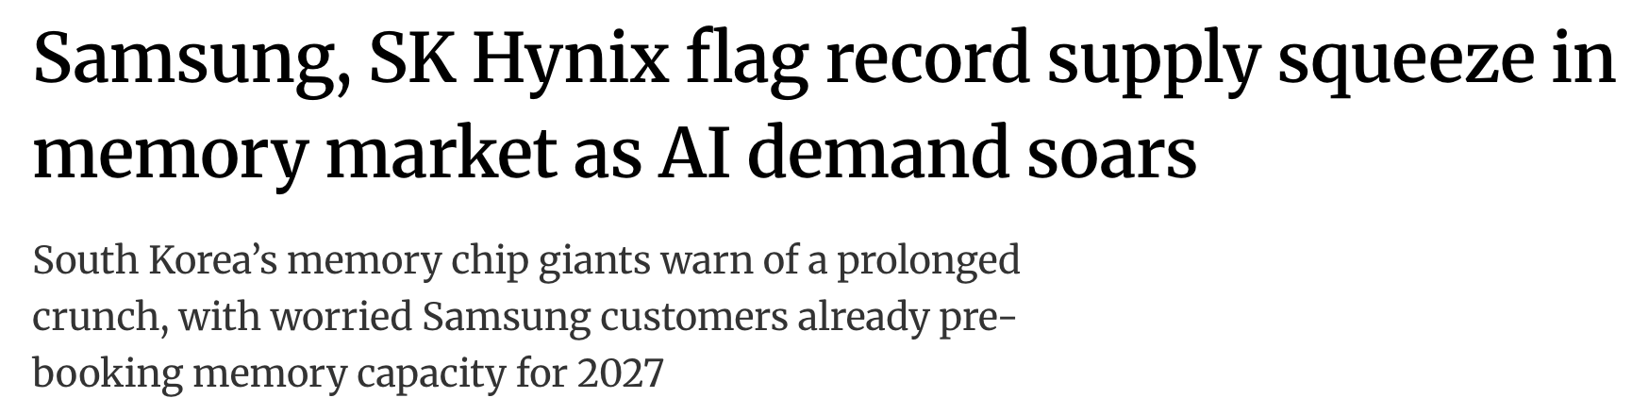
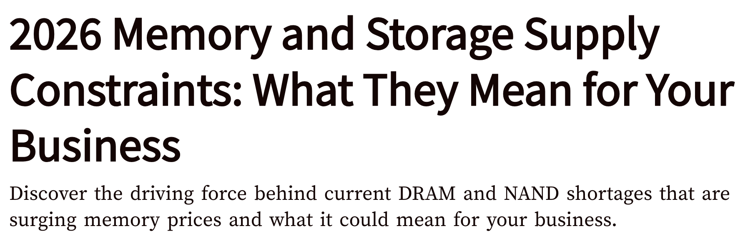
Supply Dynamics: What Drove Strong Earnings Growth in Tech/AI/Memories
Supply remains constrained…The dynamics…
HBM itself remains supply-constrained, with capacity largely committed through 2026–2027 (SK Hynix/Samsung flag record supply squeeze into 2027)
As HBM output ramps, it crowds out conventional DRAM capacity
UBS: HBM could consume 25% of industry DRAM front-end capacity by end-2026 and 31% by end-2027
JPM: Wafer allocation to HBM rising from 351k WSPM (2025) to 475k (2026E) to 633k (2027E), reducing effective supply for traditional non-HBM DRAM
UBS: With no meaningful new ex-China NAND capacity before 2028 → Limited NAND capacity & broader memory supply remains tight
At the same time, AI is lifting demand for both HBM and server DRAM
Together, these dynamics keep memory markets tighter for longer
Result:
Tightening supply-demand conditions grants producers higher pricing power & sustain HBM/DRAM/NAND Average Selling Price (ASP) increases
A richer product mix (i.e. more HBM, server-grade DDR5/LPDDR5 (DRAM), enterprise SSDs) lifts revenue and profit per wafer (These are premium products)
Source: South China Morning Post, UBS, J.P. Morgan Research.
20

Slide 21
05
2H26 Key Positive Catalysts
CSOP Asset Management

Slide 22
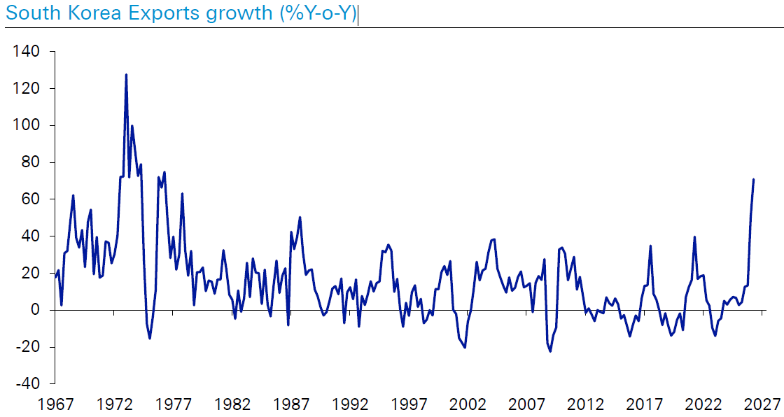
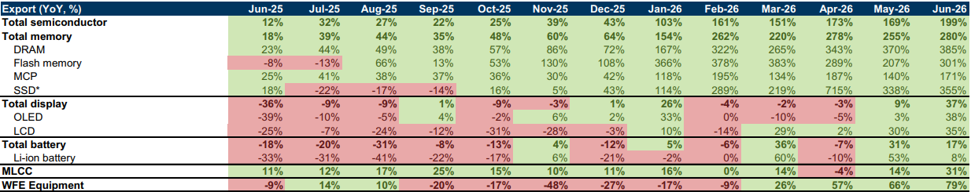
Key Positive Catalysts: Memory Exports at Fastest YoY Pace in 50 Years
Figure 5.1 — South Korea Exports Growth (%YoY)
Figure 5.2 — Monthly Exports Trends (US$ mn, %)
[Chart: South Korea Exports Growth (%YoY)]
Fastest YoY pace in 50 years
Total exports +71% YoY (June 2026)
[Table: Monthly Exports Trends of Korean Tech Products]
Memory exports +280% YoY
DRAM +385%, NAND +301%, SSD +355%
Export Strength (June 2026):
Total exports: +71% YoY — 50-year strongest pace
Total Semiconductor exports: +199% YoY | Total Memory exports: +280% YoY
DRAM: +385% YoY | NAND flash: +301% YoY | SSD: +355% YoY
Could support another robust 2Q/3Q earnings cycle for Korea's memory complex
Reinforces the view that sector earnings momentum remains intact, even as the AI trade becomes less one-dimensional
Source: Deutsche Bank, Goldman Sachs.
22

Slide 23
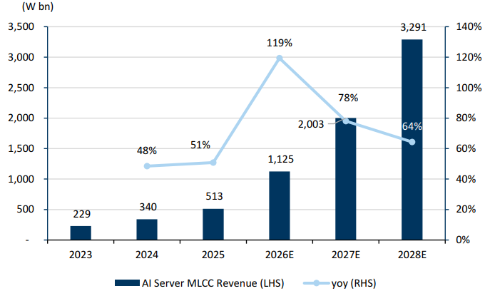
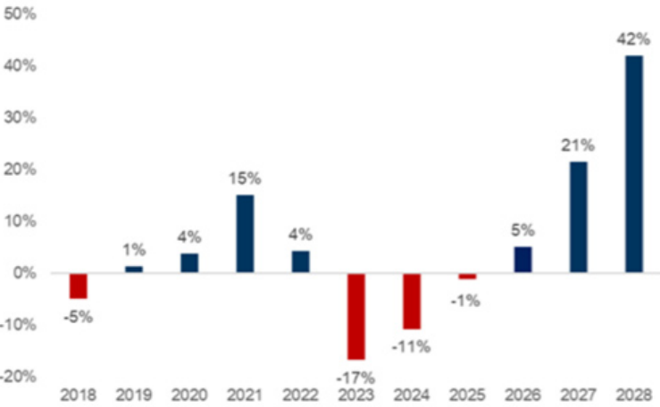
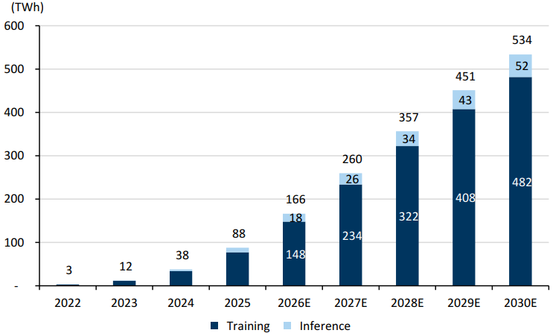
Key Positive Catalysts: AI Capex Broadening into Components: SEMCO MLCC, ABF Substrates, AI Server Power
Figure 5.3 — SEMCO AI Server MLCC Revenue Forecast
Figure 5.4 — ABF Industry Supply Shortage Forecast
Figure 5.5 — AI Server Power Demand Forecast
[Chart: SEMCO AI Server MLCC Revenue]
6.4x growth from 2025 to 2028
[Chart: ABF Industry Supply Shortage]
Favorable supply-demand for 18-24 months
[Chart: AI Server Power Demand]
Rising to 534 TWh by 2030E
AI Component Growth Opportunities:
GS: SEMCO AI-server MLCC revenue to grow 6.4x from 2025 to 2028
ABF substrate supply-demand favorable for 18-24 months given strong AI-server demand, higher layer counts, and limited near-term capacity additions
AI server power demand rising significantly to 534 TWh by 2030E — a massive new demand driver for power infrastructure and component suppliers
AI capex is broadening beyond core memory into Korean component names
Korea's opportunity set in 2H26 should widen beyond memory into AI supply-chain, industrial, and power-related beneficiaries
Term | What it is | Why it matters for AI
SEMCO MLCC | Tiny capacitors made by Samsung Electro-Mechanics that help regulate and stabilise power on boards | AI servers need many more MLCCs because high-power chips require cleaner, more reliable power delivery
ABF substrates | Advanced packaging substrates that connect high-end chips to the board and carry dense electrical signals | AI GPUs and accelerators need more complex, higher-performance packaging, which lifts ABF demand
Source: Goldman Sachs.
23

Slide 24
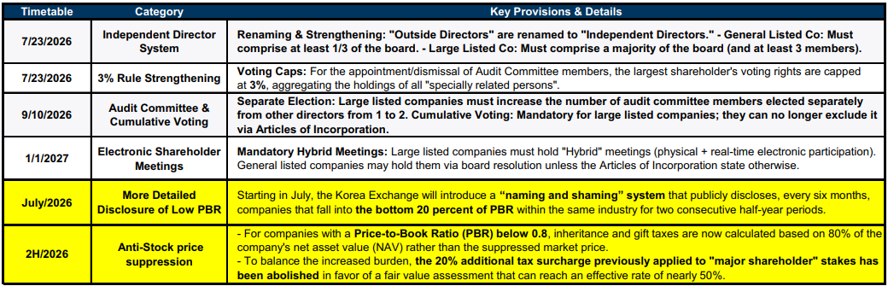
Key Positive Catalysts: Corporate Governance Reform: Low-PBR Disclosure and Anti-Stock-Price-Suppression
Figure 5.6 — Korea's Governance Reform Policy Pipeline
[Table: Korea's Governance Reform Policy Pipeline]
Second phase of Commercial Act reform
July 2026 KRX low-PBR disclosure regime
Anti-stock-price-suppression measures
Independent director system strengthening
3% rule strengthening, audit committee reforms
Governance Catalysts:
Second phase of Commercial Act reform — strengthens minority shareholder influence through mandatory cumulative voting & more independent audit committee at listed firms
July 2026 KRX low-PBR disclosure regime — requiring companies trading below book to explain valuation and improvement plans
Anti-stock-price-suppression measures — targeting practices that artificially depress share prices
Why Governance Reform Matters for Investors
The convergence of regulatory pressure (KRX disclosure regime), legislative reform (Commercial Act amendments), and market forces (active investor engagement) creates a unique window for governance improvement in Korea
Could lift shareholder returns and narrow discounts
>70% of KOSPI companies still trade below book value — discounts remain wide enough for meaningful re-rating room
Companies with high insider ownership and low P/B ratios stand to benefit most. Key beneficiaries: low-PBR financials, holding companies, etc.
Source: Goldman Sachs.
24

Slide 25
06
2H26 Key Risks and Headwinds
CSOP Asset Management

Slide 26
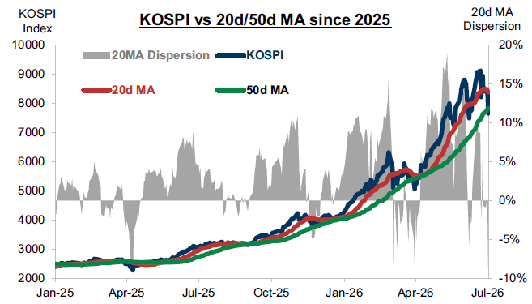
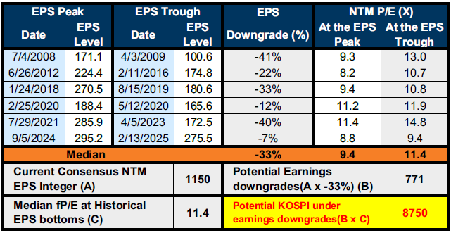
Key Risks & Headwinds: Seasonality and Technicals Could Make the Path More Volatile
Figure 6.1— Time Series of KOSPI vs. 20d/50d Moving Average Dispersion
Figure 6.2 — KOSPI Historical Cyclicity & Valuation
[Chart: KOSPI vs. 20d/50d Moving Average Dispersion]
KOSPI prone to corrections when above key MAs
[Chart: KOSPI Historical Cyclicity & Valuation]
Historical EPS peak-to-trough: median -33%
Current NTM P/E at historical troughs: 11.4x
Technical Risks:
Limited Downside Risks:
3Q has exhibited weaker seasonality historically — a period of elevated correction risk
KOSPI has been prone to corrections when trading materially above key moving averages (20d/50d)
Seasonality/technicals could make the path more volatile, but Goldman Sachs believes the trend remains upward
This table: apply median peak-to-trough EPS downgrades and trough valuations provides a downside framework for the index
Goldman Sachs: Historical peak-to-trough EPS downgrades suggest even under a historical downgrade scenario (-33%), cyclical KOSPI downside appears bounded (KOSPI still at ~8750)
GS: Limited downside risk; medium-term outlook constructive if further earnings upside continues to support the market
Source: Goldman Sachs.
26

Slide 27
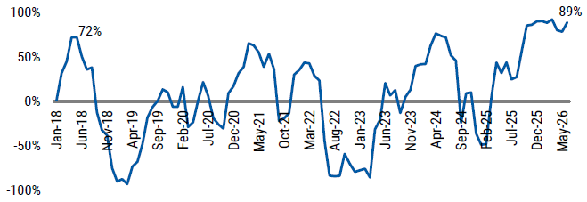
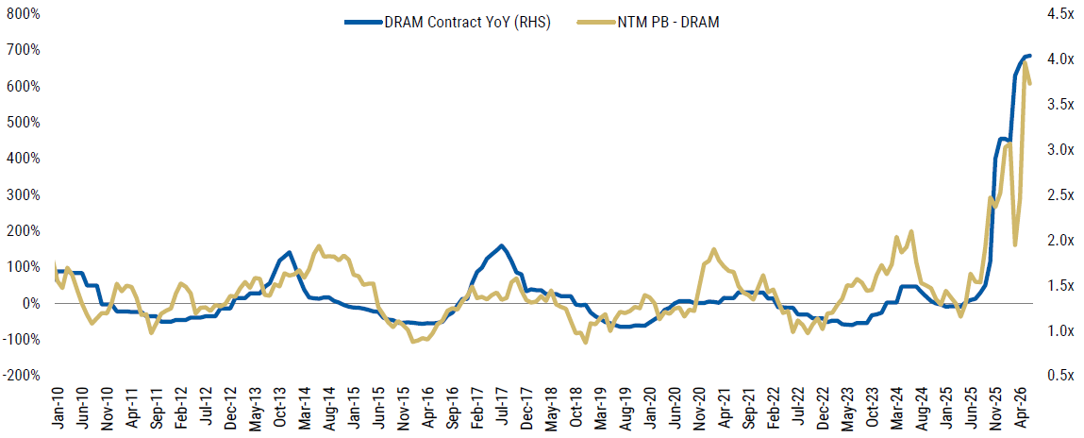
Key Risks & Headwinds: Crowded AI-Memory Positioning: DRAM Earnings-Revision Breadth Near Historical Extremes
Figure 6.3 — Time Series of DRAM Earnings Revision Breadth
Figure 6.4 — Time Series of DRAM Price YoY vs. Stock P/B
[Chart: DRAM Earnings Revision Breadth]
Near historical extremes
High proportion of DRAM companies with upward revisions
[Chart: DRAM Price YoY vs. DRAM Stock P/B]
Memory stocks pricing in strong DRAM pricing
Vulnerable to "sell-the-news" on any disappointment
Positioning Risk Warning:
Memory is now one of the most crowded segment of the AI complex, with DRAM earnings-revision breadth near historical extremes
What does that mean? Upward revisions are overwhelmingly dominating downward revisions in the DRAM universe
MS: Vulnerable if stop improving as fast as expected; Downside triggers: Slower hyperscaler AI capex, improved token efficiency, concerns over AI monetisation
Morgan Stanley:
Strong earnings backdrop continues to validate the rally in memory stocks;
Sharp corrections are both normal and healthy when positioning becomes this crowded
Pullbacks may be necessary for the bull market/cycle to continue — crowded positioning needs to reset for the next leg higher
Source: Morgan Stanley.
27

Slide 28
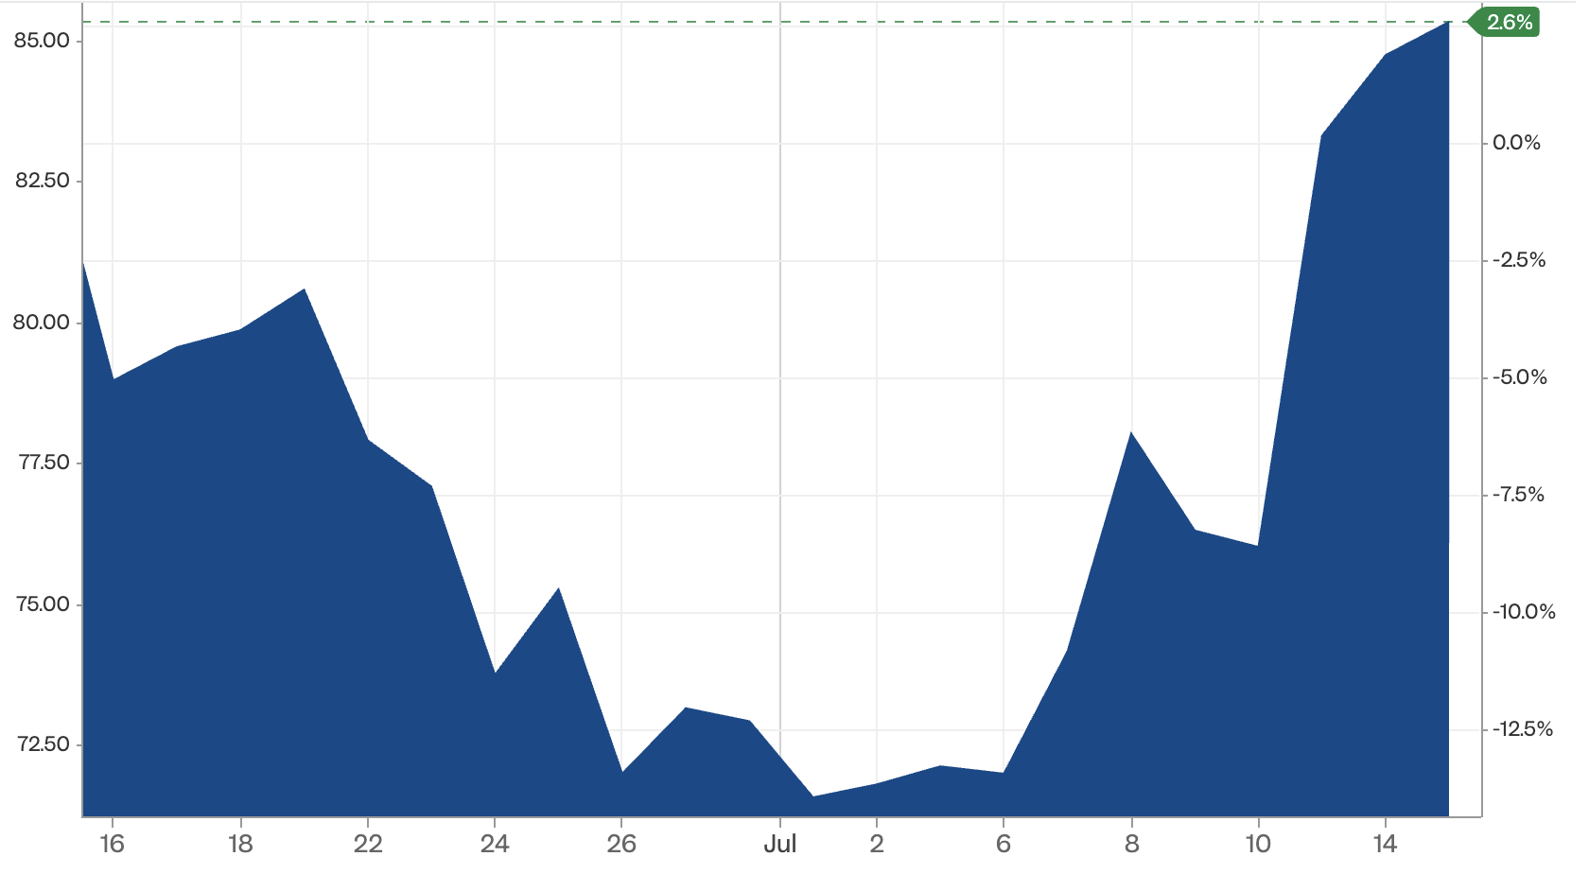
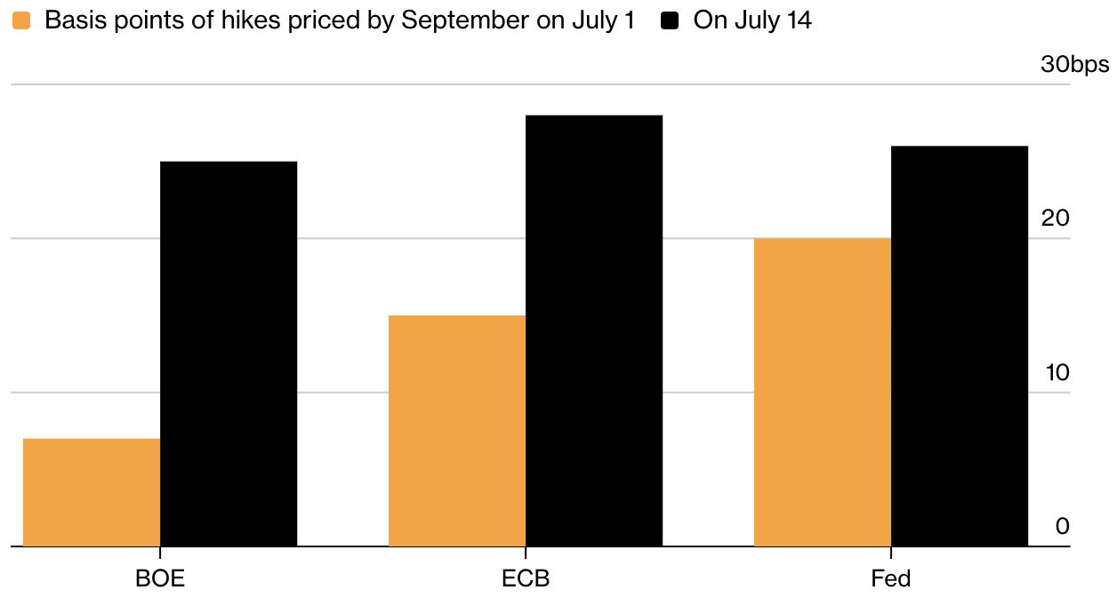
Key Risks & Headwinds: Macro Risks: Higher-for-Longer Rates, Oil Risks, and BOK Rate Hike
Figure 6.5 — Time Series of Brent Crude Oil Price (1M)
Figure 6.6 — Market Implied Rate Hikes by September on July 1 vs. July 14 (bps)
[Chart: Fed Funds Rate vs. Policy Rule Prescriptions]
Taylor rule, Balanced Approach, Williams Rule
Sticky inflation may keep rates higher for longer
[Chart: Fed Funds Rate and Historical Crises Annotated]
US-Iran conflict adds oil-driven inflation risk
Higher rates compress EM valuations
Macro Risk Factors:
Inflation vs. Energy Risks: June’s surprise US CPI drop (-0.4% MoM) was eclipsed by the renewed US-Iran conflict (supply disruption in the Strait of Hormuz). Oil spiking to ~$85/bbl could cloud the Fed's rate-cut timeline
Hawkish Rate Repricing: Energy shock forced sharp shift in global rate expectations. Markets aggressively priced in September rate hikes for the Fed, ECB, BoE
Valuation Compression Risk: If global central banks maintain tighter financial conditions, higher discount rates could compress KOSPI valuations given its high beta
BOK Rate Hike: Stronger US dollar pushed KRW to ~1,500 (weakest level since 2009). To combat inflation and won slump, BOK hiked its base rate to 2.75% (with 3.00% expected by year-end). Combined with higher global rates, this creates a double-squeeze on domestic liquidity and equity valuations.
Source: Deutsche Bank, Bloomberg, Reuters, The Guardian.
28

Slide 29
07
2H26 Index and Stock Targets
CSOP Asset Management

Slide 30
Index and Stock Targets: Consensus KOSPI Range 9,200–12,500
Target | Goldman Sachs | J.P. Morgan | UBS | Current | Upside
KOSPI | 12,000 | 12,500 | 9,200 | 6,800 | 35-84%
Samsung Elec. | 480,000 | — | 550,000 | 254,500 | 89-116%
SK Hynix | 3,500,000 | — | 3,200,000 | 1,845,000 | 73-90%
Goldman Sachs
J.P. Morgan
UBS
KOSPI target raised to 12,000 in early June (from 9,000). Constructive on Korea — raised target on strong earnings momentum and still-depressed valuations.
KOSPI target 12,500 — keeps Korea as its top market in Asia. Most bullish among major brokers on the back of memory upcycle and earnings momentum.
KOSPI target 9,200. Warns of possibility of near-term consolidation following the strong rally and lingering rate concerns, but remains constructive medium-term.
KOSPI is trading around the 7,600 level (as of early July 2026). Sell-side sentiment remains firmly constructive, with most base-case target scenarios ranging from 9,000 to 12,500 — implying 35-84% upside from current levels.
The wide target range reflects differing views on the durability of the memory cycle, the pace of governance reform, and the macro outlook — but all major brokers agree the risk-reward remains favorable.
Source: Goldman Sachs, UBS, J.P. Morgan. As of 13/07/2026 noon.
30

Slide 31
Why Sell-Side Remains Constructive: EPS Upgrades and Still-Depressed Valuations
Samsung Electronics
SK Hynix
UBS forecasts:
Operating profit: KRW 441tn (2026E) → KRW 837tn (2027E) / +90%YoY
Free cash flow: KRW 226tn → KRW 565tn / +150% YoY
Additional shareholder returns: KRW 104tn → KRW 273tn / +163% YoY
Goldman Sachs: Stronger DRAM and NAND pricing, accelerating HBM shipment momentum, improving export indicators point to continued earnings upside.
UBS forecasts:
Operating profit: KRW 327tn (2026E) → KRW 623tn (2027E) / +91% YoY
Price does not fully reflect structurally higher DRAM profitability, stronger FCF, and enhanced shareholder returns
HBM leadership: Expected to maintain 50% of industry bit shipments in 2026. HBM to rise from 15% of DRAM revenue (2026) to 58% by 2030.
Core Constructive Thesis – Recap of Positive Catalysts
KOSPI targets underpinned by powerful EPS upgrades and still-depressed valuations
Memory cycle: AI-driven HBM, DRAM and NAND demand, together with supply discipline, supports a potentially more durable "higher-for-longer" pricing cycle
Samsung and SK Hynix should benefit through gradual bit-volume growth, stronger ASPs, and a shift toward higher-value products
A richer product mix (more HBM, server-grade DDR5, enterprise SSDs) lifts revenue and profit per wafer, while broader conventional-memory tightness supports pricing of the rest of the portfolio
Source: Goldman Sachs, UBS.
31

Slide 32
Sector Recommendations: Four Preferred Themes for 2H26… and Key Risks to Watch…
1
Memory Leaders
2
AI & Power-Linked Components
AI-led HBM demand and constrained conventional-memory supply should sustain pricing, mix and earnings upside for Memory Leaders:
Tech / AI EPS: +464% in 2026E; represents 60% of KOSPI market cap
Earnings Inflection: Samsung operating profit: KRW 44.1tn in 2026E to KRW 83.7tn in 2027E; SK hynix: KRW 32.7tn to KRW 62.3tn
AI capex is moving beyond memory into power delivery and advanced packaging, creating a multi-year growth runway for component suppliers:
SEMCO AI-Server MLCC Revenue: forecast to grow 6.4x from 2025–28E
ABF Supply-Demand: favourable for 18–24 months
AI-Server Power Demand: projected to reach 534 TWh by 2030E
3
Industrials & "Physical AI"
4
Governance / Value-Up
Re-industrialisation, energy security and grid investment broaden the earnings cycle into defence, shipbuilding, electrical equipment and automation:
Foreign Flows: rotated into broader industrial themes
Broadening Recovery: Construction, shipbuilding, industrials, defense show strong earning growth / positive revisions
Governance reform creates a credible path to unlock Korea’s persistent valuation discount, favouring low-PBR financials and holding companies:
Valuation runway: >70% of KOSPI companies still trade below book value
Policy catalysts: Phase II Commercial Act reform, July 2026 low-PBR disclosure regime, and anti-stock-price-suppression measures
Priced for Perfection
Crowding Can Unwind Quickly
Record earnings are increasingly priced in; the forward hurdle is now sustained AI capex, memory pricing and peak-cycle margin durability:
Samsung fell 7% despite record Q2 earnings (19x YoY in operating profit), shifting focus to peak growth and forward margin durability.
Fundamentally, the AI-memory thesis remains intact, but extreme positioning raises the probability of sharp technical corrections:
KOSPI fell more than 20% from its June peak in early July; profit-taking in Samsung and SK Hynix triggered circuit breakers.
Source: Goldman Sachs, UBS, J.P. Morgan Research.
32

Slide 33
核心结论与关键要点：2026年韩国市场速览
1
上半年回顾：盈利驱动与极端分化
2
杠杆风险可控与波动性机制
KOSPI 年内累计上涨约90%，但涨势极度狭窄——科技与半导体贡献了约87%的指数涨幅，市场广度严重不足，为疫情以来最弱。
本轮为典型的盈利驱动行情：EPS 增长超250%，而非估值扩张推动。
“韩国折价”依旧存在：前瞻市盈率不升反降，压缩至约6.6倍，估值并未泡沫化。
涨幅高度集中于少数龙头，景气一旦反转，易引发获利了结与踩踏式抛售。
绝对杠杆升至历史高位（约270万亿韩元），但相对杠杆仅为自由流通市值的约6.2%。
保证金贷款/存款比率实际在下降， 系统性风险有限，主要风险为波动放大。
两大波动放大器：散户融资强制平仓与杠杆ETF的“做空gamma效应”相互叠加，加剧单边波动。
2026年7月FSC监管收紧：重点整顿单一个股杠杆型ETF（三星电子、SK海力士相关产品）。现金保证金门槛由1,000万韩元大幅上调至3,000万韩元（须全额现金），并提高最小交易单位。
3
下半年展望：曲折向上与核心催化剂
4
宏观逆风与“双重挤压”风险
核心多头逻辑不变，指数“曲折向上”：存储周期强劲，HBM产能挤压传统DRAM供给，从而提供更强的定价权、更优的产品组合及更高的利润空间。
景气兑现于出口— 6月出口同比激增约71%，创历史新高。
AI需求向电源与零部件扩散：三星电机（SEMCO）MLCC、ABF载板等持续受益。
2026年韩国EPS增长预期258–320% 。
“价值提升计划”（Value-Up）持续推进：超70%的KOSPI公司仍破净。
公司治理改革（KRX低PBR披露制度、商法修订）有望推动估值修复。
拥挤的“AI—存储”多头仓位叠加7月美伊冲突油价冲击，布伦特原油升至约85美元/桶，压制风险偏好。
全球利率“更高更久”重新定价：美联储、欧洲央行、英国央行政策趋鹰，压制成长股估值。
国内“双重挤压”：韩元走弱至约1,500，迫使韩国央行（BOK）加息至2.75%以对抗输入型通胀。
汇率贬值与被动加息并存，构成“宏观双重挤压”，是下半年估值压缩的最大尾部风险。
33

Slide 34
Thank You Korea Market Outlook 2H26

